Slide 1
Introduction to Public Health
Module # 7B
Tobacco consumption/ smoking and its prevention
DR. SHAIKH ABDUS SALAM
Dept. of Public Health
North south University

Slide 2
OBJECTIVES OF THE LECTURE
By the end of this lecture you will be able to:
Conceptualize
  The harmful effects of tobacco consumption.
  Smoking behaviors.
  planning & policies to control smoking tobacco
Understand the feasibilities of reducing manufacturing and consumption of tobacco in Bangladesh.
Dr. Shaikh Abdus Salam
1

Slide 3
Smoking and it’s impacts on health
SMOKING AND IT’S
IMPACTS ON HEALTH
& SOCIETY
Dr. Shaikh Abdus Salam

Slide 4
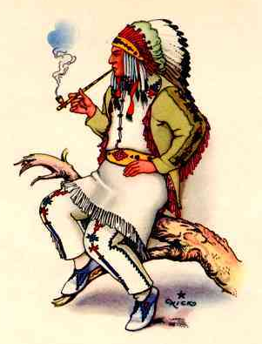

Tobacco History
Jean Nicot de Villemain introduces tobacco to France, promotes importation and cultivation (1556)
Chewed recreationally, used for ailments (e.g. headaches, colds) in Europe (1500s)
Tobacco becomes major cash crop of American colonies, spurring demand for slave labor (1600s)

Slide 5
Why do people smoke?
As a result of curiosity
To relax
To socialize with peers – “peer pressure”
To deal with stress & distress
Seek psychological satisfaction
Socioeconomic status
Cultural characteristics
Price of tobacco products
Advertising (for and against)
Notes:
Biological elements
Peer pressure

Slide 6

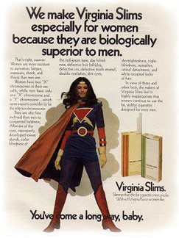

Advertising

Slide 7
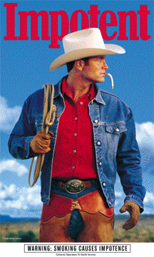
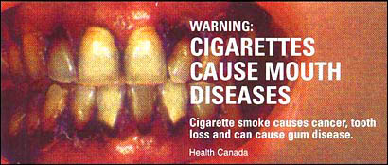
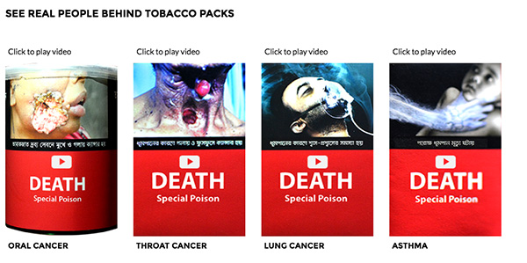
Anti-Smoking Ad Campaigns
Scare tactics

Slide 8
Facts
Most addictive drug
Smoking causes lung cancer- 1950
Smoking behaviour is responsible for epidemic of lung cancer
Causes more long term health problems than any other drug
Also causes
  Cardiovascular disease
  Chronic lung disease
  Low birth weight (LBW)
  Depression
  Skin becomes thinner and wrinkled

Slide 9
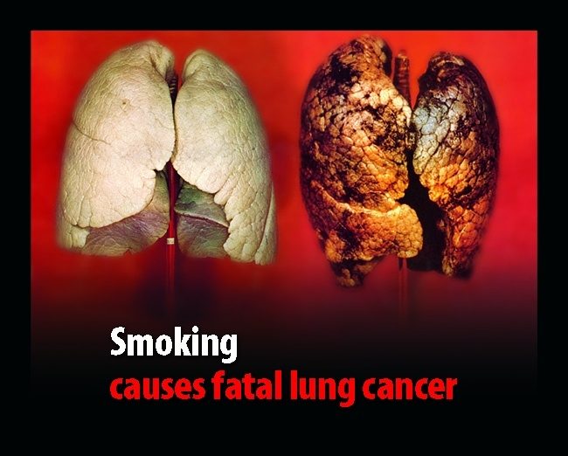

Slide 10
Role of public health
PH fought tobacco industries many fronts
  1960: balanced ads in TV and radio
  Warning labels in packets
  Sophisticated marketing
PH interventions
  Prevented the onset of smoking
  Reduced its prevalence
  Enforcement of law to sale to minors
  Restricted indoor smoking
  Imposed taxes to hike price

Slide 11
Policies and the ordinance in Bangladesh
1890: Article of the railways act
  20 taka fine ☺
  Removed from the carriage
1919: Juvenile Smoking Act
  Prohibited selling or giving to apparently 16< yrs
  Fine 10 taka/ 20 taka/ 50 taka
2005: Smoking and using tobacco products (control) act
  Defined public place
  Prohibited advertising in favour
  Health warning messages on packets
2006: Smoking and using tobacco products (control) rules
  Specified smoking zones

Slide 12
Policies and the ordinance in Bangladesh (contd.)
2013: Smoking and using tobacco usage (control) amendment
2015: Smoking and using tobacco usage (control)
  Rules to control displaying of usage of tobacco products in movies
  Responsibility of the owner and related persons of the public place or public transport
  Display of caution notice regarding smoke-free area
  Pictorial display on packets
2016: Public notice
  print pictorial health warnings at least on the 50% area of the lower part of any packet, carton or can containing tobacco products

Slide 13
Some terminologies
Epidemic
  The occurrence in a community or geographic area of disease at a rate that clearly exceeds the normally expected rate
  Low birth weight
  Weight at birth of less than 2500g. Very LBW means weight at birth of less than 1500g
  Cardiovascular disease
  Disease of the heart and blood vessels
  Carcinogenic
  A substance or agent that is known to cause cancer

Slide 14
Trends / current status
In 2003, the smoking prevalence among adults was 54.8% in males and 16.6% in females.
The prevalence was 1.6% in the age group 10-14, 2.8% among males and 0.1% among females.
Dr. Shaikh Abdus Salam

Slide 15
Trends / current status
29% school going adolescent males practice smoking and 55% males start smoking during adolescence who do not go to school.
Average number of cigarettes smoked: The annual cigarette consumption per person: 245
Dr. Shaikh Abdus Salam

Slide 16
Trends / current status
Adolescent smoking is alarming, because tobacco is considered to be a "gateway drug", the use of which may lead to alcohol, marijuana and other drug abuse and high-risk behaviors in the long term.
Dr. Shaikh Abdus Salam

Slide 17
Main Forms of Tobacco Used in Bangladesh
Cigarettes
Bidi/Biri
Pipe
Cigar
Hubble-bubble
Gul
Zarda
Chew tobacco etc.
Dr. Shaikh Abdus Salam

Slide 18
Commercial Tobacco
Contents
4000 Chemicals
40 Cancer causing agents
500 Poisons
Dr. Shaikh Abdus Salam

Slide 19
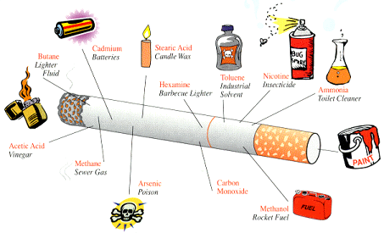
There are over 4,000 chemicals in tobacco smoke
Each puff on a cigarette delivers nicotine to your brain within a few seconds.
However, the Nicotine levels in your blood drop quickly after your cigarette is done.
After 20 or 30 minutes you may feel the urge to smoke again.

Slide 20
There are over 4,000 chemicals in tobacco smoke
Each puff on a cigarette delivers nicotine to your brain within a few seconds.
However, the Nicotine levels in your blood drop quickly after your cigarette is done.
After 20 or 30 minutes you may feel the urge to smoke again.
Dr. Shaikh Abdus Salam

Slide 21
Nicotine
Poisonous
More addictive than cocaine and heroine
So powerful that farmers can use it to kill insects
Legal addiction
Use results in addiction
  Mood leveler
  Users rely on it to control emotional responses to everyday life
Dr. Shaikh Abdus Salam

Slide 22
Carbon Monoxide
The compound is present in car exhaust that can cause death.
Causes shortness of breath.
Reduces the amount of oxygen carrying capacity of blood.
Dr. Shaikh Abdus Salam

Slide 23
Tar
Sticky Residue that stains the fingers and teeth.
Contains benzopyrene, one of the deadliest cancer causing agent.
Dr. Shaikh Abdus Salam

Slide 24
Chemicals
Acetone: fingernail polish remover
Ammonia: floor/toilet cleaner
Cadmium: content of batteries
Arsenic: rat poison
Methane: content of cow manure fumes
Formaldehyde: preserver of dead bodies
Dr. Shaikh Abdus Salam

Slide 25
Metals
Silver
Lead
Copper
Mercury
Heavy metals
Dr. Shaikh Abdus Salam

Slide 26
Metals
Aluminum
Magnesium
Zinc
Silicon
Titanium
Dr. Shaikh Abdus Salam

Slide 27
Nicotine dependence
Central nervous system Pleasure and arousal,
Improved short term memory,
Improved concentration and
Decreased anxiety
Cardiovascular system Increased heart rate and blood pressure and peripheral vasoconstriction
Dr. Shaikh Abdus Salam

Slide 28
Nicotine dependence
Endocrine system Increased circulating catecholamines (eg. adrenaline and noradrenalin) and increased cortisol levels
Metabolic system Increased basal metabolic rate
Gastrointestinal system Decreased appetite, nausea
Skeletal muscle Decreased tone
Dr. Shaikh Abdus Salam

Slide 29
Nicotine dependence
Central nervous system | Pleasure and arousal, Improved short term memory, Improved concentration and Decreased anxiety
Cardiovascular system | Increased heart rate and blood pressure and peripheral vasoconstriction
Endocrine system | Increased circulating catecholamines (eg. adrenaline and noradrenalin) and increased cortisol levels
Metabolic system | Increased basal metabolic rate
Gastrointestinal system | Decreased appetite, nausea
Skeletal muscle | Decreased tone

Slide 30
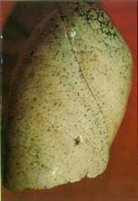
Normal Lung
Dr. Shaikh Abdus Salam

Slide 31
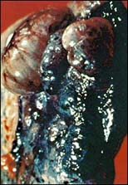
Lung Cancer
Dr. Shaikh Abdus Salam

Slide 32
Impact of Smoking tobacco
Smoking causes:
Pneumonia
Asthma
Bronchitis
Lung cancer
Dr. Shaikh Abdus Salam

Slide 33
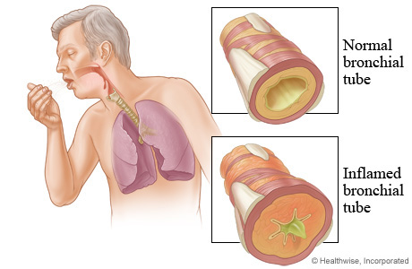
Impact of Smoking tobacco
Dr. Shaikh Abdus Salam

Slide 34
Bronchitis
Bronchitis: is an inflammation of the lung airways resulting in persistent cough. It may become due to smoking.
Dr. Shaikh Abdus Salam

Slide 35
Bronchitis
Chronic bronchitis is a chronic inflammatory condition in the lungs that causes the respiratory passages to be swollen and irritated, increases the mucus production and may damage the lungs.
Dr. Shaikh Abdus Salam

Slide 36
Bronchitis
The symptoms are coughing and breathlessness, which will get worse over the years.
Chronic bronchitis is defined as chronic cough or mucus production for at least three months in two successive years when other causes have been excluded.
Dr. Shaikh Abdus Salam

Slide 37
Lung Cancer
Lung cancer kills more people than any other type of cancer and at least 80% of these deaths are caused by smoking.
It is the tar in the `cigarettes which contains the carcinogenic “cancer causing” substances
Dr. Shaikh Abdus Salam

Slide 38
Cancer
Cigarette tar contains some of the most carcinogenic chemicals. During smoking the tar not only come in contact with lung, but tar also come in contact with lips, tongue, larynx, oesophagus and throughout the digestive tract. Smokers have increased incidents of cancer in all of these exposed sites.
Dr. Shaikh Abdus Salam

Slide 39
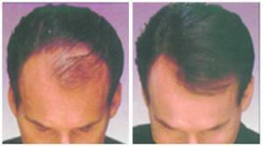
Effects of Smoking
Dr. Shaikh Abdus Salam

Slide 40
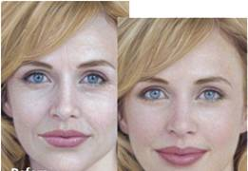
Effects of Smoking
Dr. Shaikh Abdus Salam

Slide 41
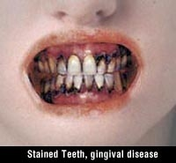
Effects of Smoking
Dr. Shaikh Abdus Salam

Slide 42
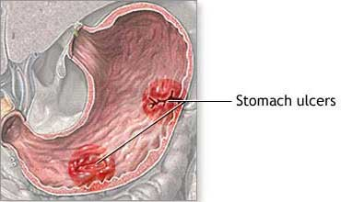
Effects of Smoking
Dr. Shaikh Abdus Salam

Slide 43
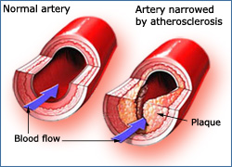
Effects of Smoking
Dr. Shaikh Abdus Salam

Slide 44
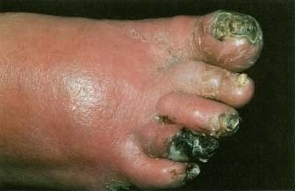
Effects of Smoking
Dr. Shaikh Abdus Salam

Slide 45
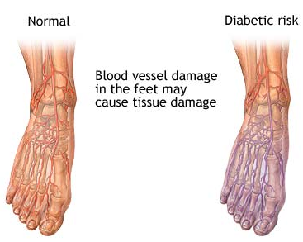
Effects of Smoking
Dr. Shaikh Abdus Salam

Slide 46
Effects of Smoking
Smoking and Diabetes both reduce the amount of oxygen reaching body tissues, which results in poor circulation.
Smoking raises blood sugar level making it harder to control diabetes.
Of people with diabetes who need amputations, 95% are smokers.
Dr. Shaikh Abdus Salam

Slide 47
Effects of Smoking
Smoking increases blood cholesterol level and hardens arteries. Thus nicotine acts as a vessel constrictor and reduces blood flow to different parts the body.
Diabetes increases cholesterol level and the levels of some other fats in our blood.
The combined cardiovascular risks of smoking and diabetes is as high as 14 times those of either smoking or diabetes alone.
Dr. Shaikh Abdus Salam

Slide 48
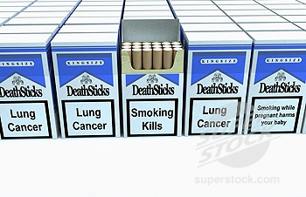
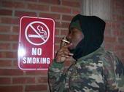
Dr. Shaikh Abdus Salam

Slide 49
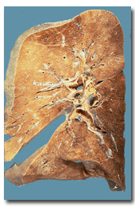
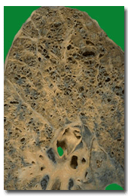
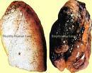
Why cigarette smoking is bad for us?
Everyone knows that smoking can cause cancer when you get older, but did you know that it also has bad effects on your body right now? A cigarette contains about 4000 chemicals, many of which are poisonous. Some of the worst ones are:
Nicotine: a deadly poison
Arsenic: used in rat poison
Methane: a component of rocket fuel
Ammonia: found in floor cleaner
Cadmium: used in batteries
Carbon Monoxide: part of car exhaust
Formaldehyde: used to preserve body tissue
Butane: lighter fluid
Hydrogen Cyanide: the poison used in gas chambers
Every time you inhale smoke from a cigarette, small amounts of these chemicals get into your blood through your lungs. They travel to all the parts of your body and cause harm.
Following figure showing a normal & diseases lung:
Dr. Shaikh Abdus Salam

Slide 50
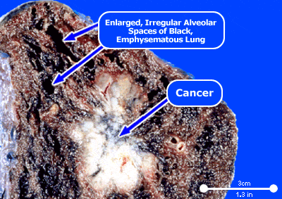
What is Cancer of Lung?
Cancer of the lung, like all cancers, results from an abnormality in the body's basic unit of life, the cell. Normally, the body maintains a system of checks and balances on cell growth so that cells divide to produce new cells only when needed. Disruption of this system of checks and balances on cell growth results in an uncontrolled division and proliferation of cells that eventually forms a mass known as a tumor.
Dr. Shaikh Abdus Salam

Slide 51
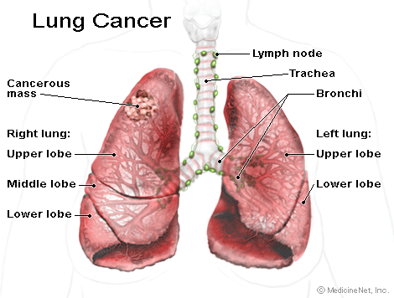
Continued..........
Lung cancers can arise in any part of the lung, but 90%-95% of cancers of the lung are thought to arise from the epithelial, or lining cells of the larger and smaller airways (bronchi and bronchioles); for this reason, lung cancers are sometimes called bronchogenic carcinomas or bronchogenic cancers. Cancers can also arise from the pleura (the thin layer of tissue that surrounds the lungs), called mesotheliomas, or rarely from supporting tissues within the lungs, for example, blood vessels.
Dr. Shaikh Abdus Salam

Slide 52

Symptoms of Lung Cancer
Symptoms of primary lung cancers include cough, coughing up blood(Hemoptysis), chest pain, and shortness of breath.
Repeated respiratory infections, such as bronchitis or pneumonia, can be a sign of lung cancer.
Symptoms of metastatic lung tumors depend on the location and size. About 30%-40% of people with lung cancer have some symptoms or signs of metastatic disease.
Lung cancer most often spreads to the liver, the adrenal glands, the bones, and the brain.
Metastatic lung cancer in the liver usually does not cause symptoms, at least by the time of diagnosis.
Metastatic lung cancer in the adrenal glands also typically causes no symptoms by the time of diagnosis.
Metastasis to the bones is most common with small cell cancers but also occurs with other lung cancer types. Lung cancer that has metastasized to the bone causes bone pain, usually in the backbone (vertebrae), the thighbones, and the ribs.
Lung cancer that spreads to the brain can cause difficulties with vision, weakness on one side of the body, and/or seizures.
Dr. Shaikh Abdus Salam

Slide 53
Risk Factors for Lung Cancer
Tobacco Smoking: The Deadliest Habit
Asbestos exposure
Family history
Recurring Inflammation of the lung
Carcinogens in the workplace
Marijuana use
Radon exposure
Indoor & Outdoor air pollution
Dr. Shaikh Abdus Salam

Slide 54
Diagnostic procedures and tests to diagnose lung cancer
History and physical examination
Chest X-ray
CT (computerized axial tomography scan, or CAT scan) scans
Low-dose helical CT scan or spiral CT scan)
Magnetic resonance imaging (MRI)
Positron emission tomography (PET)
Bone scans
Sputum cytology
Bronchoscopy
Needle biopsy(FNAC)
Dr. Shaikh Abdus Salam

Slide 55
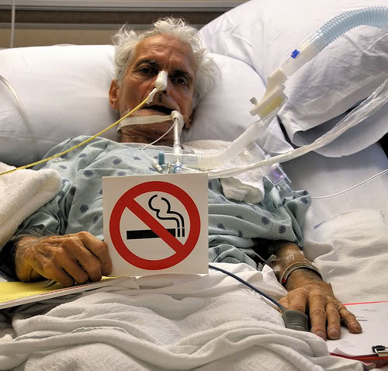

What to do for Prevention of Lung Cancer?
Please don't smoke
Dr. Shaikh Abdus Salam

Slide 56
Preventive Approach:
Cigarette Smoking is highly addictive & quitting often proves to be difficult.
Health care provider play an important role in identifying smokers & helping them quit.
Many products such as nicotine gum, nicotine sprays, nicotine inhalers & others type of
medications have been successfully used to help people trying to quit smoking.
Minimization exposure to passive smoking is also an effective preventive measures.
Smokers who use a combination of supplemental nicotine, group therapy & behavioral training shows a significant drop in smoking rates.
1. Quit smoking - NOW
2.Fruits and vegetables are rich with antioxidants and flavonoids. Antioxidants and flavonoids help protect your cell's DNA and repair damaged cells.
3. Have your home tested for radon
4. Know what you are being exposed to in the workplace.
5. Keep away from secondhand smoke.
5 Ways To Prevent Lung Cancer
Dr. Shaikh Abdus Salam

Slide 57
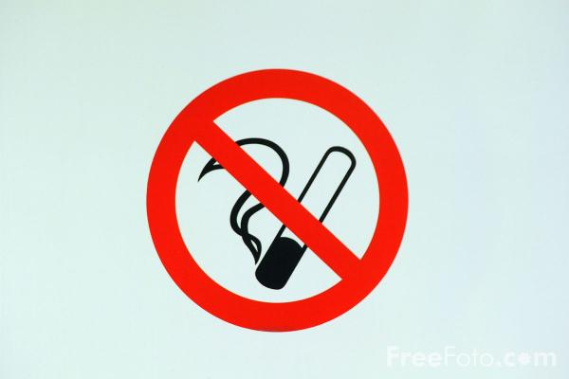

Thank You
Dr. Shaikh Abdus Salam

